Slide 1
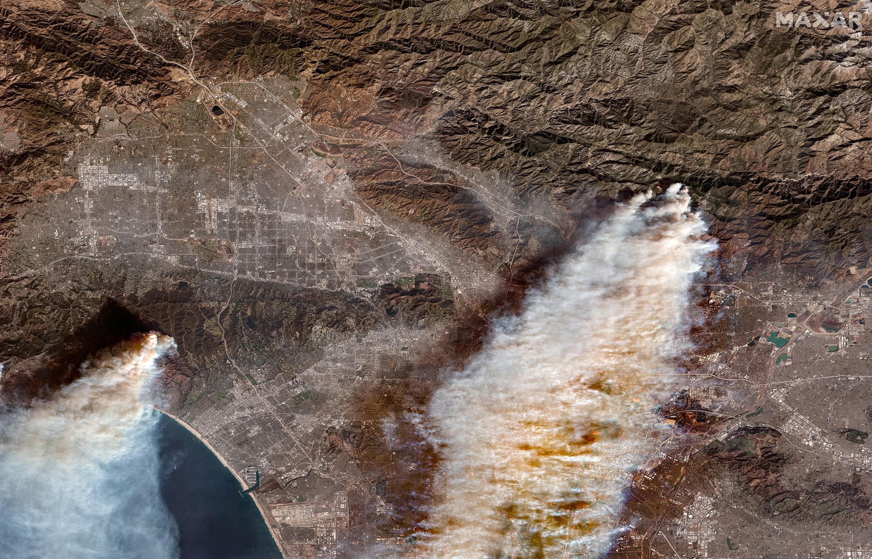
View of the Eaton and Palisades Fires from TROPESS
Kevin W. Bowman¹, Josh Laughner¹, Frank Werner¹, Le Kuai¹, and the full TROPESS Team¹
¹Jet Propulsion Laboratory, California Institute of Technology

Slide 2
A new standard for destruction
The Eaton Fire destroyed over 9,400 structures, while the Palisades Fire led to the loss of approximately 6,837 homes and buildings, including historic landmarks and businesses.
The combined death toll from both fires stands at 29 confirmed fatalities, with many others suffering injuries.
AccuWeather estimated that the total damage plus broader economic slowdown would add up between $250 billion and $275 billion.
That would make the 2025 Los Angeles fires the costliest natural disaster in US history.

Slide 3
The impact of this fire on atmospheric composition is being investigated.
This is what we know so far from TROPESS.

Slide 4
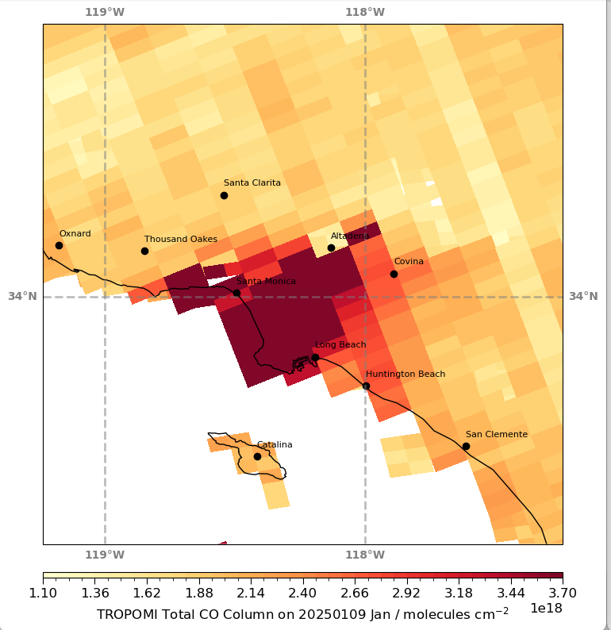
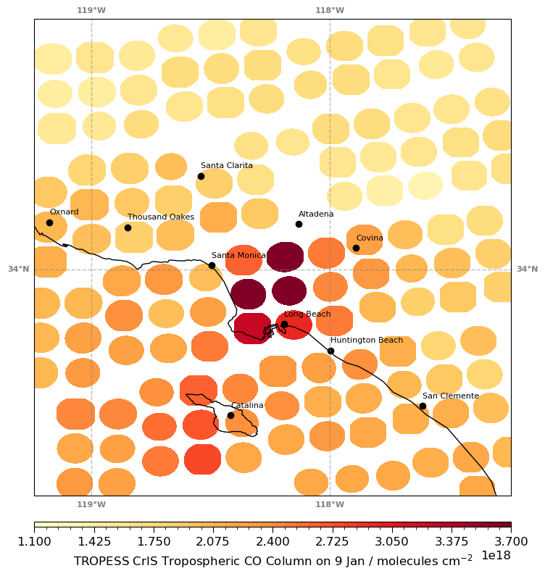
TROPOMI and TROPESS CrIS CO show distinct spatial patterns

Slide 5
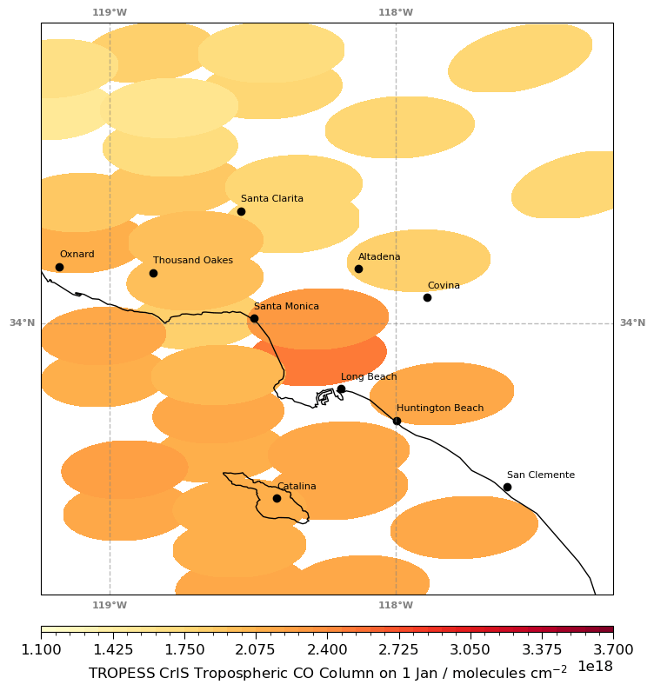
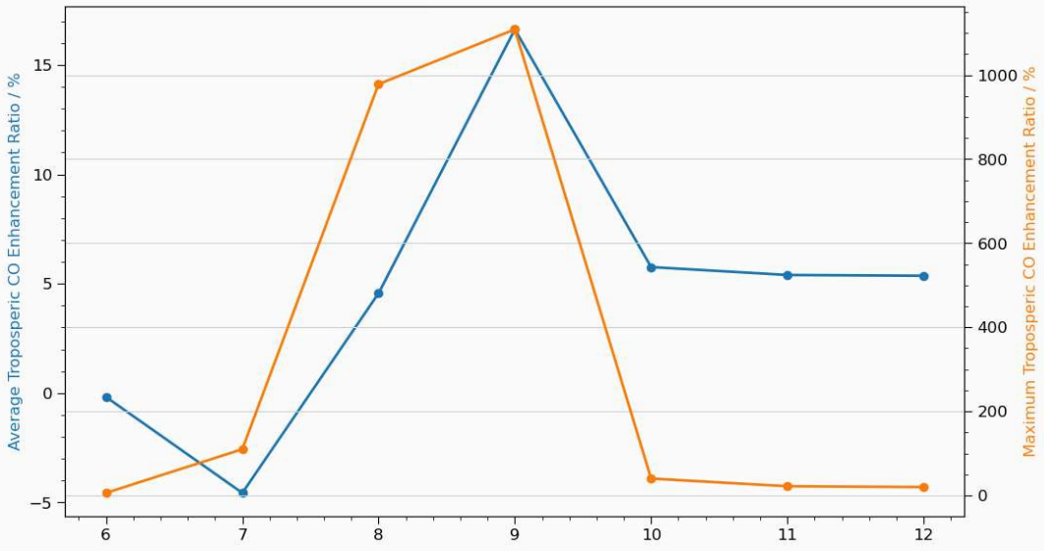
Pacific Palisades and Eaton Canyon seen from JPSS1/CrIS
Enhanced CO anomalies near Santa Monica are observed on Jan 7th
On Jan 9th, CO plumes from the Eaton Canyon fire were elevated over Los Angeles.
CrIS sensitivity suggests Eaton Canyon plumes entered the free troposphere
TROPOMI and CrIS sensitivity suggests that CO stayed near the boundary layers over the Pacific Palisades
Fire was primarily active on Jan 8-9th.
Mean CO values indicated elevated pollution at least 3 more days in the LA Basin.

Slide 6
The ammonia signature
Elevated NH₃ is observed over Pacific Palisades and especially from the Eaton Canyon fire on Jan 9th , consistent with observed CO.
Increased NH₃ over the ocean suggests a longer lifetime from being aloft.

Slide 7
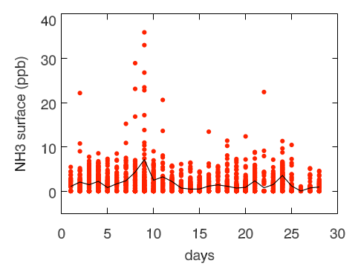
NH₃ values were over 10x higher than background values
In general, elevated NH₃ during these fires is consistent with NH₃ observed previously, e.g., 2020 LA fires.
Eaton fire and
Palisades fire
Hughes fire

Slide 8
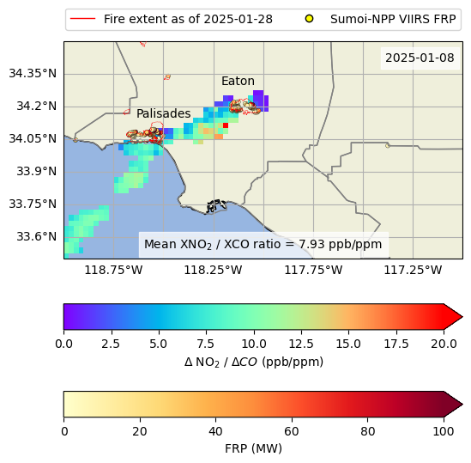
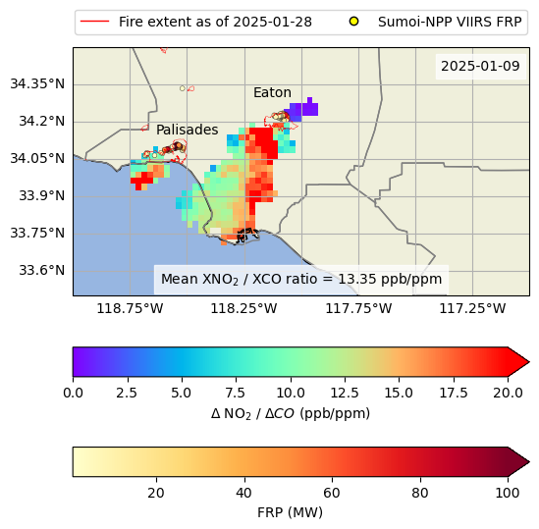
NO₂:CO enhancement ratios observed during the fires
TROPOMI observed enhancement of NO₂ and CO over background.
Background was defined as a box to the NE of the Eaton fire.
The fire extents as of late Jan are shown in red, and the VIIRS FRP for each day are shown as circles.
We are confident these enhancements are real and have several hypotheses why they are higher than previously observed for wildfires (next slide).
TROPOMI NO₂: Copernicus Sentinel-5P (processed by ESA), 2021, TROPOMI Level 2 Nitrogen Dioxide total column products. Version 02. European Space Agency. https://doi.org/10.5270/S5P-9bnp8q8
TROPOMI CO: Copernicus Sentinel-5P (processed by ESA), 2021, TROPOMI Level 2 Carbon Monoxide total column products. Version 02. European Space Agency. https://doi.org/10.5270/S5P-bj3nry0
Suomi-NPP VIIRS FRP: NASA VIIRS Land Science Team. VIIRS (S-NPP) I Band 375 m Active Fire Product NRT (Vector Data). NASA LANCE MODIS at the MODAPS, 2020, doi:10.5067/FIRMS/VIIRS/VNP14IMGT_NRT.002.
Fire extent: https://gis.data.ca.gov/datasets/f72ebe741e3b4f0db376b4e765728339_0/about, last accessed 2025-01-28.

Slide 9
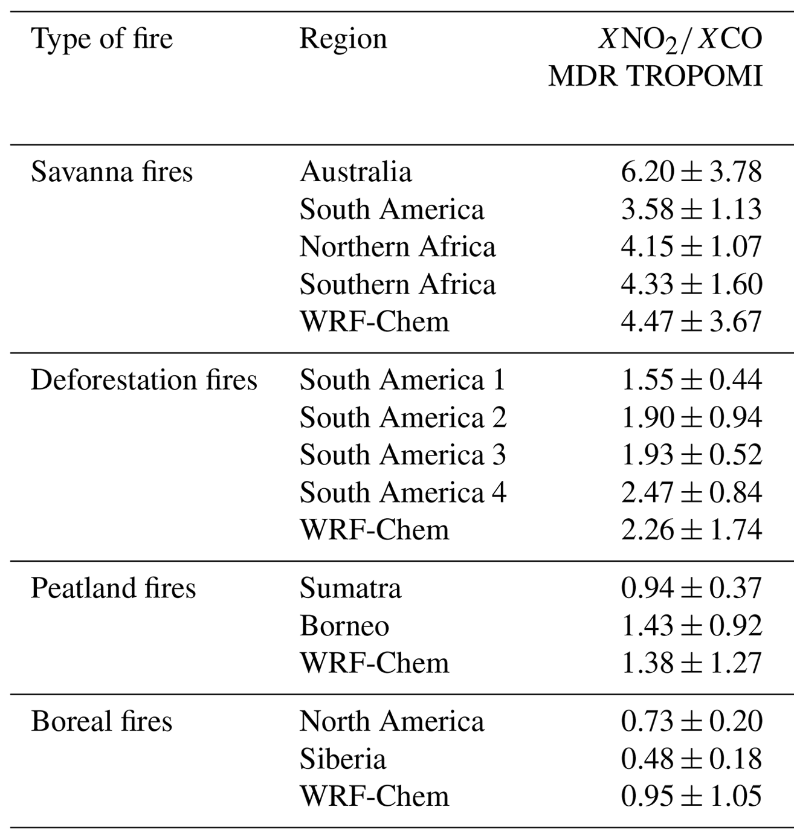
NO₂:CO enhancement ratios
Our results (top) show higher enhancement ratios than van der Verle (bottom), who looked at more regional fires.
We have three hypotheses for this difference that we plan to explore:
Higher fire temperatures. NO₂:CO ratios are generally larger for hotter fires, implying that the LA fires were hotter than usual.
Lofted fire plumes. NO₂ retrievals may return a larger NO₂ value when the NO₂ is at a higher altitude and not accounted for in the a priori profile.
Different emissions from urban fires. Emissions from burned buildings may produce a different NO₂:CO ratio than purely wildland fires.
Date | Plume mean NO₂:CO ER
2025-01-08 | 7.93 ppb / ppm
2025-01-09 | 13.35 ppb / ppm
Highest ER observed by van der Velde
Table 2 (cropped) from van der Velde, I. R., et al.: Biomass burning combustion efficiency observed from space using measurements of CO and NO₂ by the TROPOspheric Monitoring Instrument (TROPOMI), Atmos. Chem. Phys., 21, 597–616, https://doi.org/10.5194/acp-21-597-2021, 2021.

Slide 10
Conclusions/Future Directions
The 2025 Eaton and Palisades fires significantly impacted atmospheric composition in Los Angeles.
TROPESS data revealed that the Eaton Fire transported pollution, including elevated levels of CO and NH₃, aloft over downtown LA, while the Palisades Fire's impact was confined to the boundary layer.
TROPOMI observations indicated a substantial impact of urban fire emissions on NO_{x}, with higher NO₂:CO ratios compared to previous wildfire observations.
This suggests potentially higher fire temperatures, lofted fire plumes, or different emission characteristics from urban fires.
We will continue to analyze these results and will present those findings at the Gordon Research Conference in 2025.

